Slide 2
Optical Flow

Slide 3
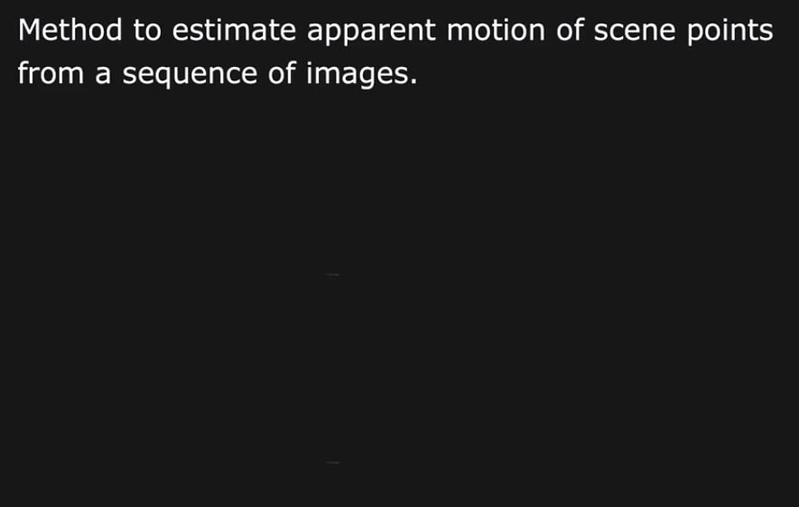
Optical Flow

Slide 4
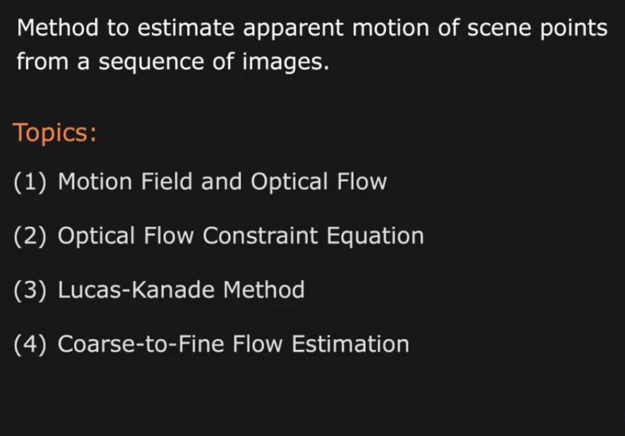
Optical Flow

Slide 5
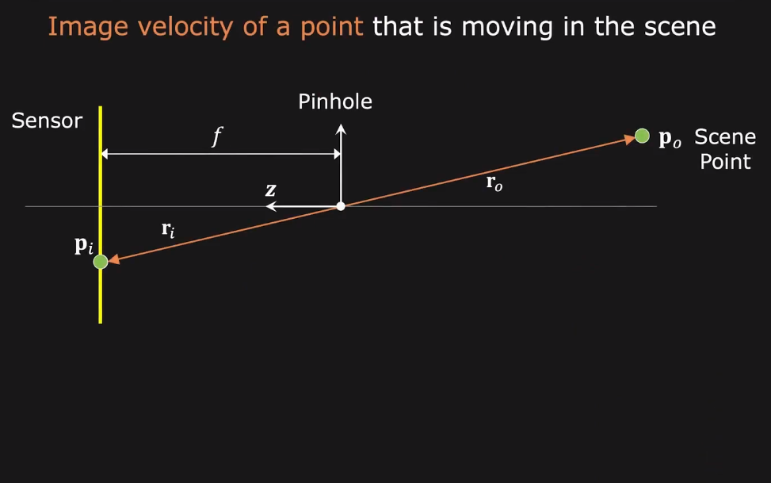
Motion Field

Slide 6
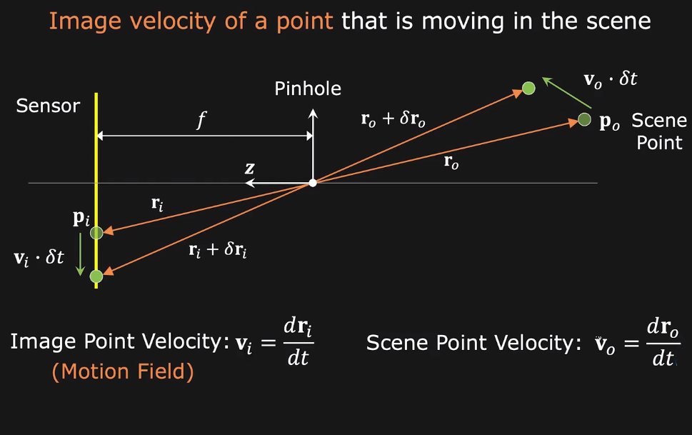
Motion Field

Slide 7
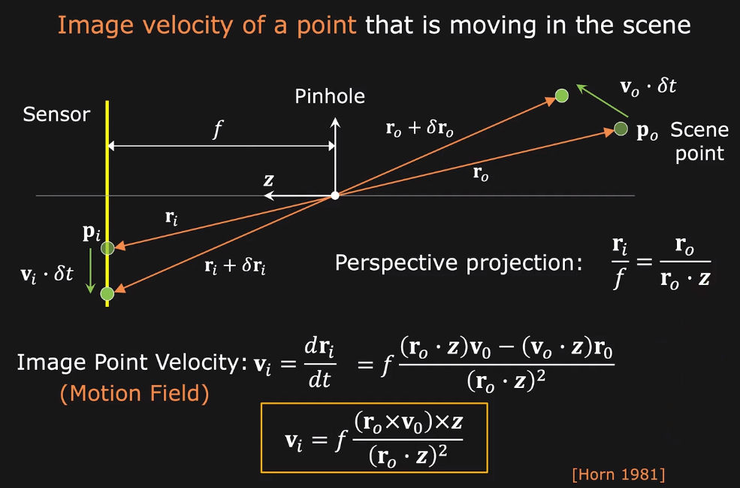
Motion Field

Slide 8
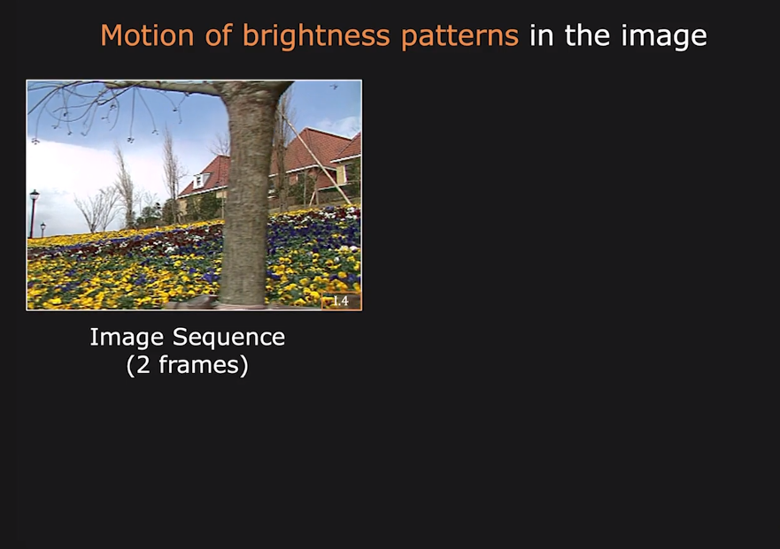
Motion Field

Slide 9
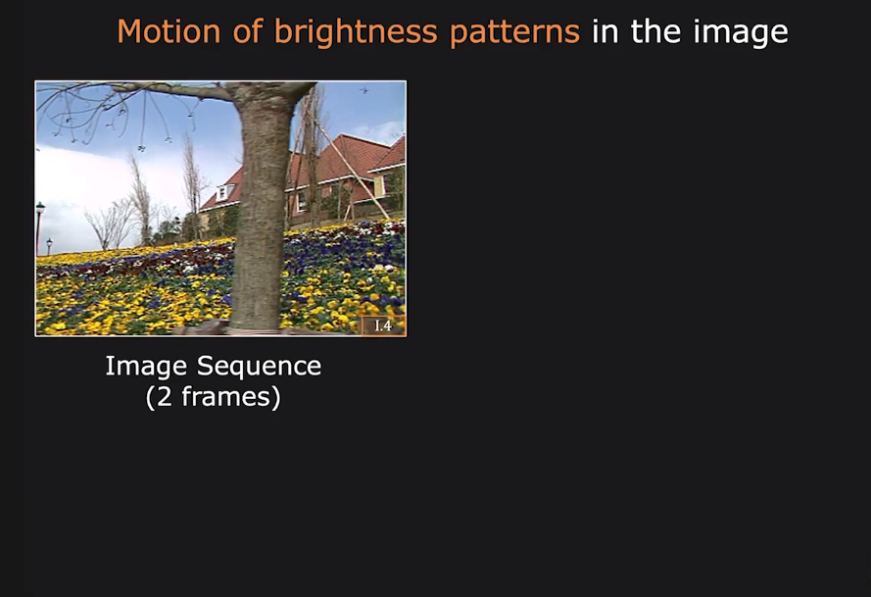
Motion Field

Slide 10
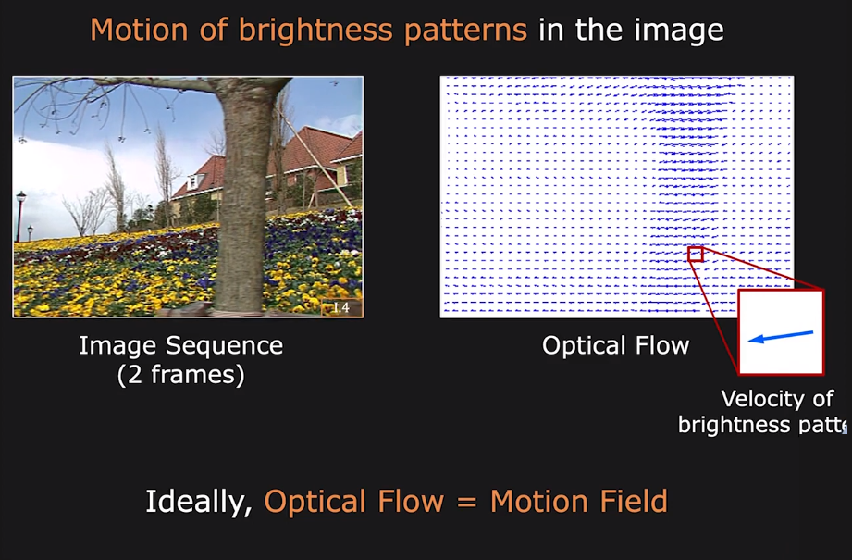
Motion Field

Slide 11
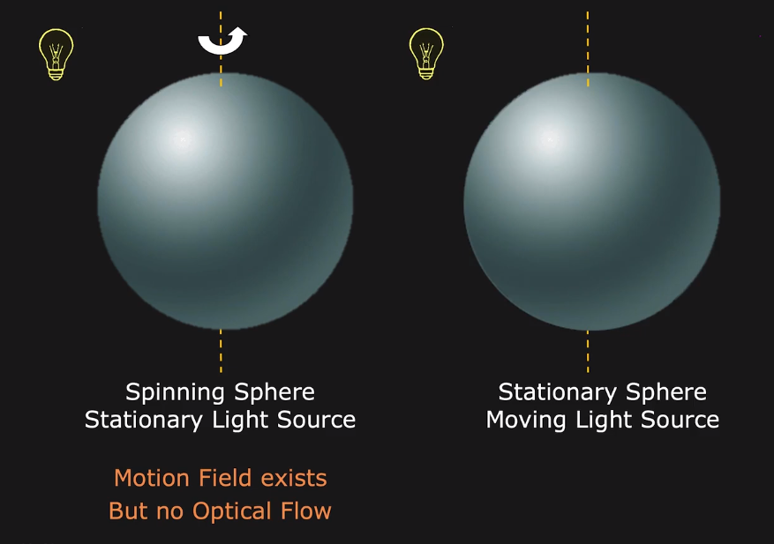
When Optical Flow is not equal to Motion Field

Slide 12
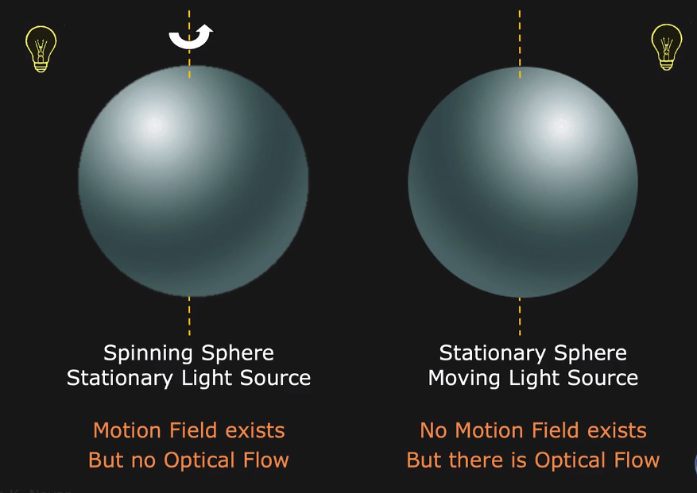
When Optical Flow is not equal to Motion Field

Slide 13
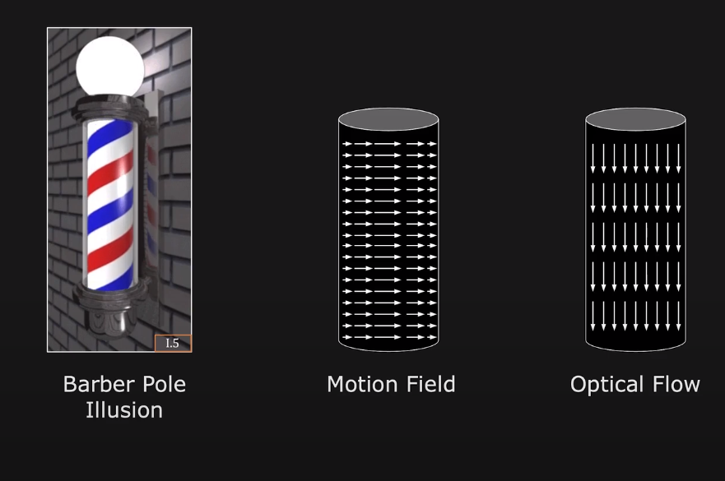
When Optical Flow is not equal to Motion Field

Slide 14
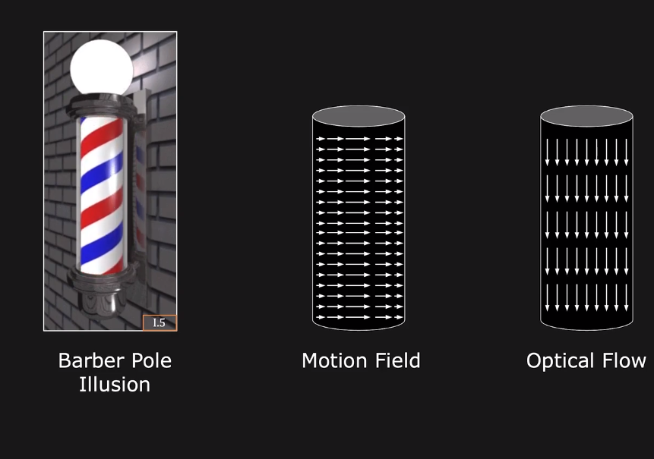
When Optical Flow is not equal to Motion Field

Slide 15
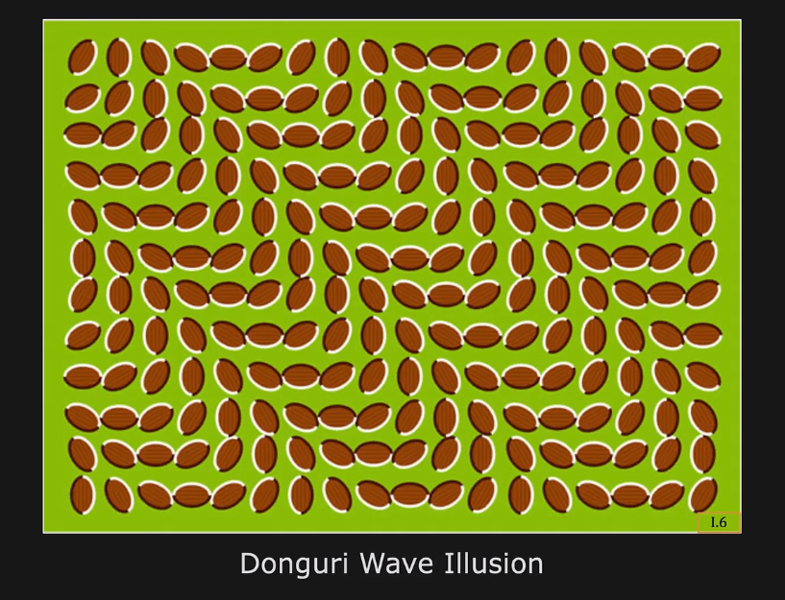
Motion Illusion

Slide 16
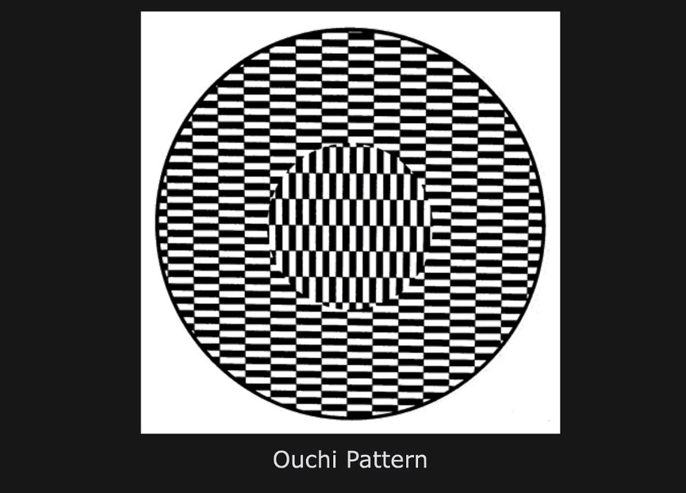
Motion Illusion

Slide 17
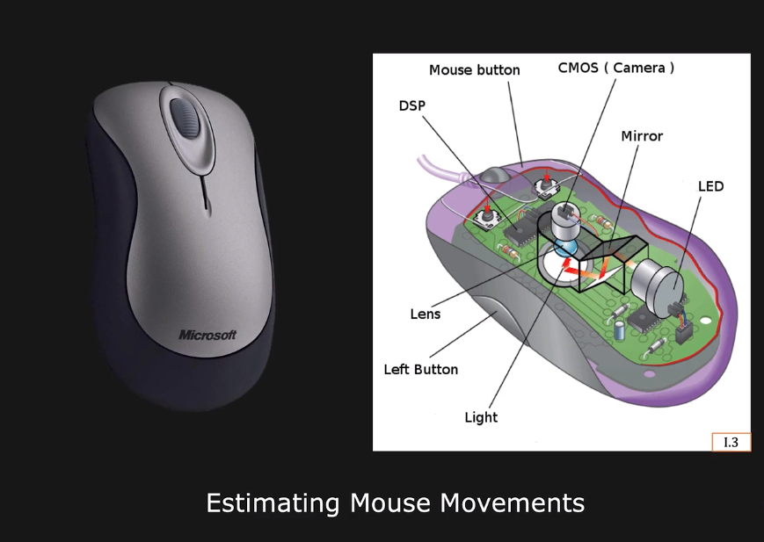
Optical Mouse

Slide 18
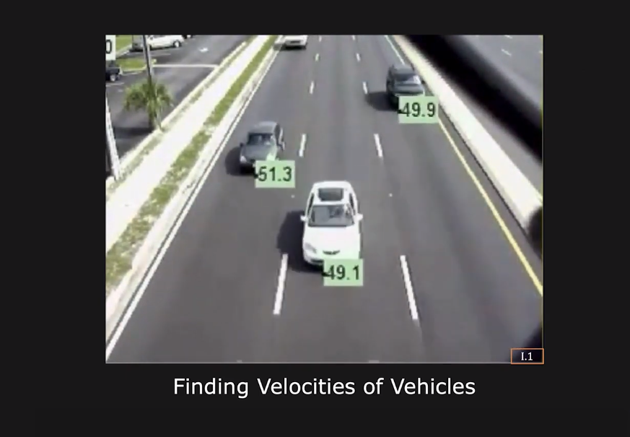
Monitoring Traffic

Slide 19
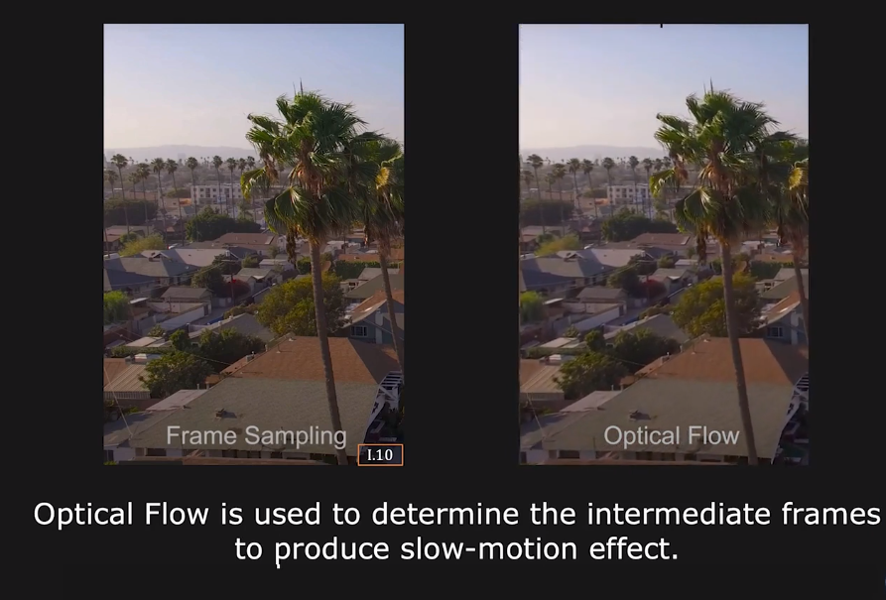
Video Retiming

Slide 20
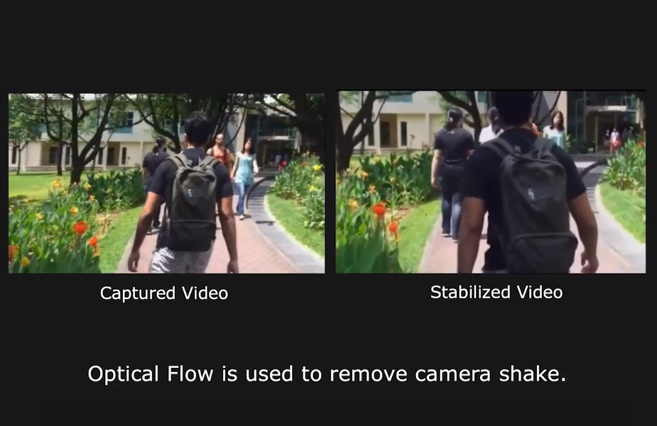
Image Stabilization

Slide 21
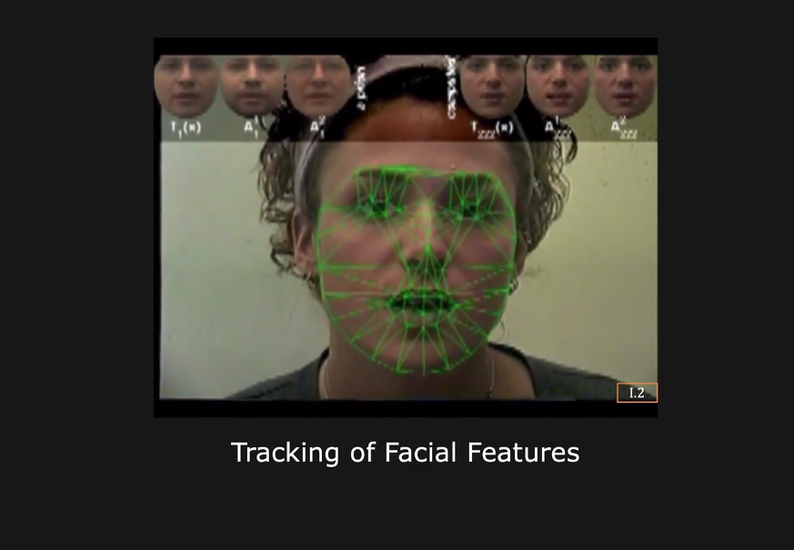
Face Tracking

Slide 22
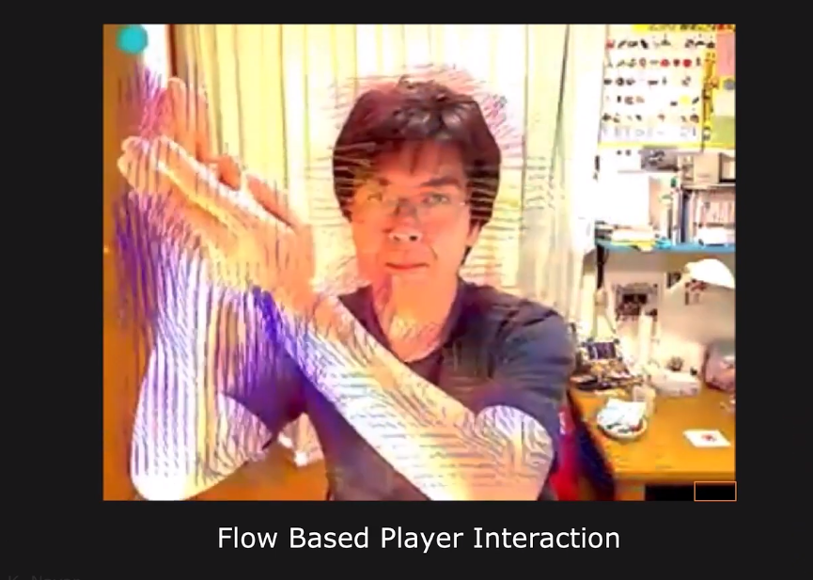
Games

Slide 23
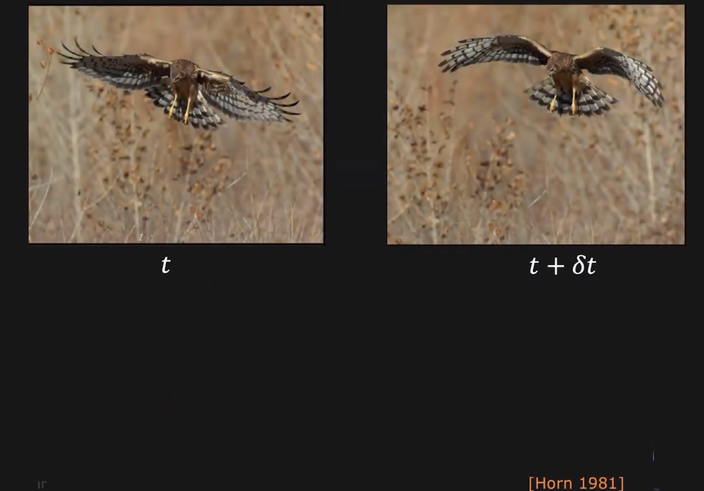
Optical Flow Modeling

Slide 24
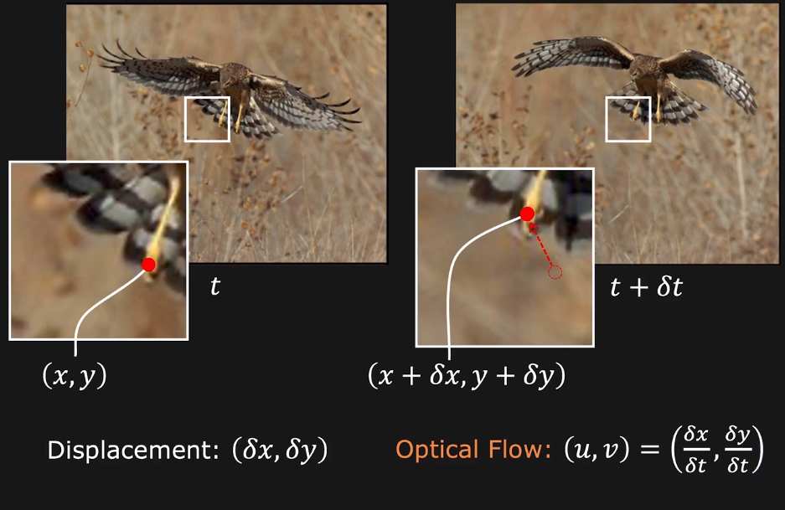
Optical Flow

Slide 25
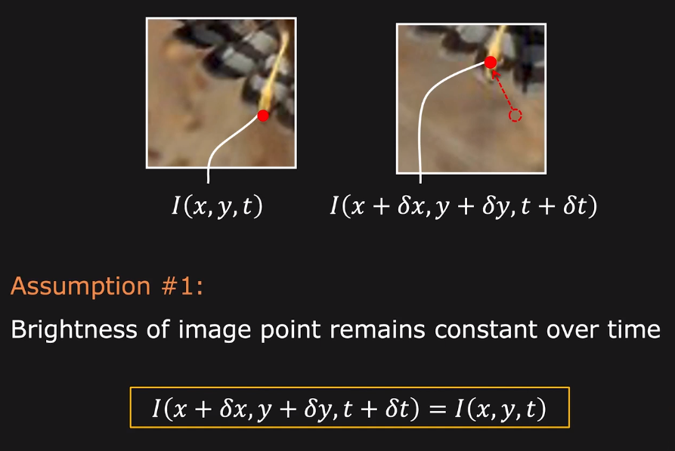
Optical Flow

Slide 26
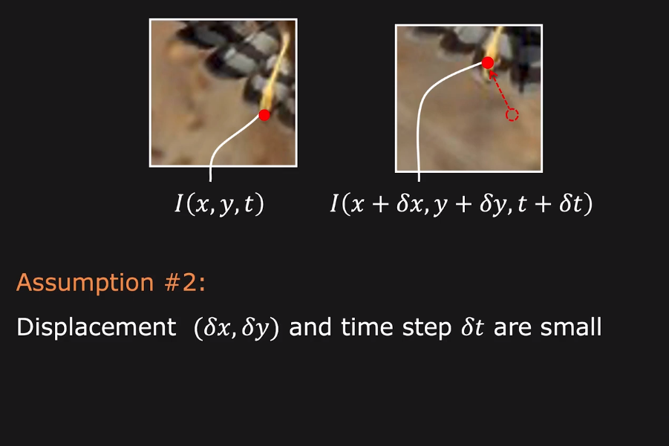
Optical Flow

Slide 27
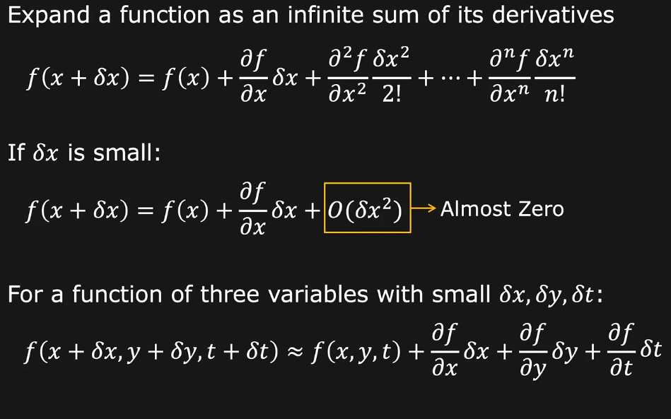
Taylor Series Expansion

Slide 28
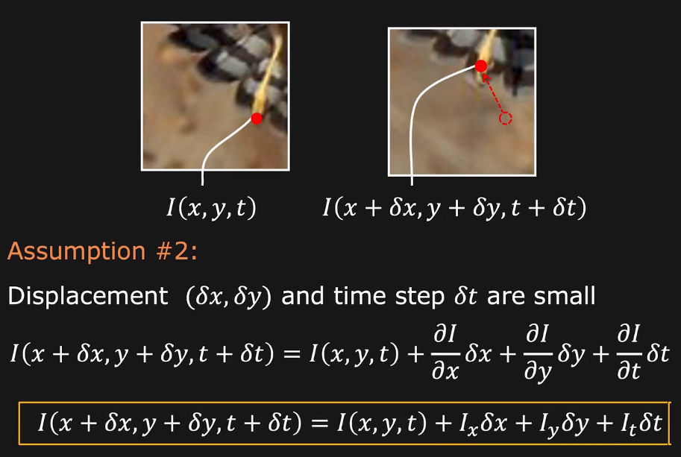
Optical Flow Constraint Equation

Slide 29
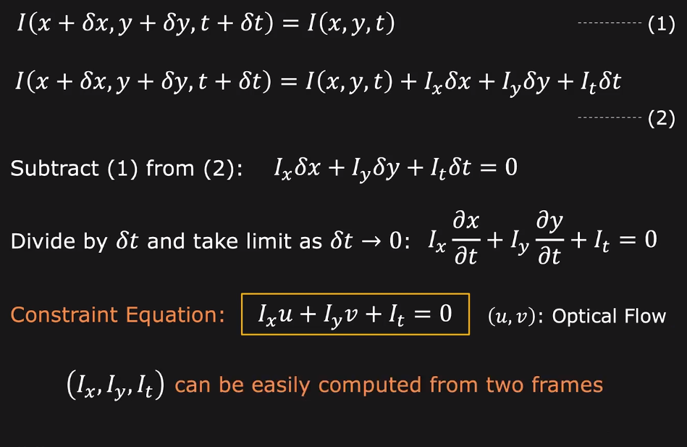
Optical Flow Constraint Equation

Slide 30
Thanks

